Slide 1


Version Bravo Ventures
Fund I

Slide 2

Investing in Veteran Entrepreneurs Who Have Already Conquered the Impossible.
Version Bravo is an Accelerator and Venture Fund run by combat veterans turned successful entrepreneurs.

Slide 3
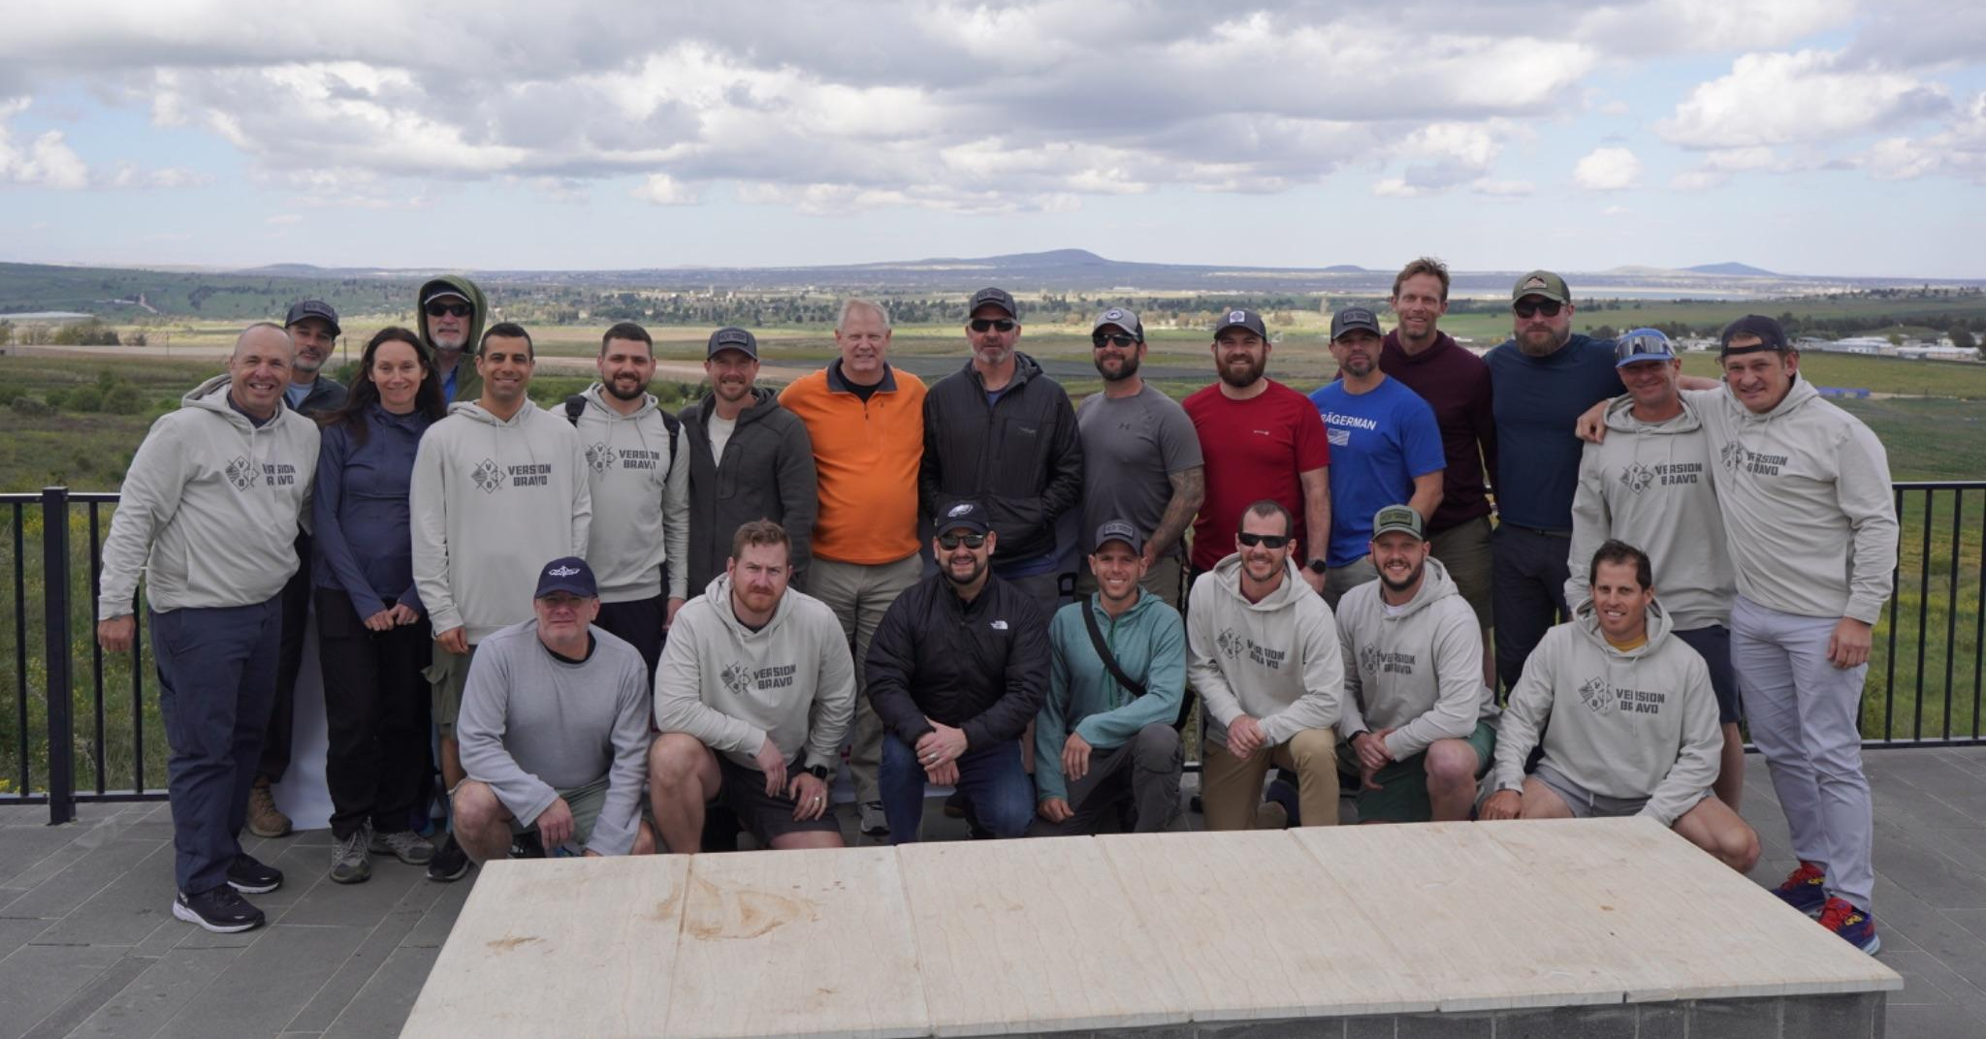
Why Entrepreneurs Choose Version Bravo?
Team of Successful Operators with a Track Record as Value-Add Advisors – We are not passive advisors, rather we are in the trenches with our Founders to make their companies successful.
Unparalleled Network of entrepreneurs, industry experts, Veterans foundations, military transition organizations.
We understand the Veteran Entrepreneur - Immediate trust built on shared experiences, values, and mindset.
Accelerator Built by and for Veteran Entrepreneurs - 4 years and graduated 58 Combat Veteran Founders
Experienced Advisory Board – Consisting of decades of VC experience and technical expertise spanning all sectors and stages.

Slide 4







Version Bravo Deal Flow
Military Service
Alpha-Bet Program
Version Bravo Ventures
VB Accelerator
Active Reservists or
Retired in last 7 years
Ministry of Employment (IL) and Unit NGOs (US & IL) to refer candidates to VB after assessment
10-week online program of lessons and workshops
500-1,000 Applicants
& 100-150 Participants
Per Year
Access to proprietary content, curriculum, mentors and network
Funded by Philanthropy + Gov’t Funding
$100,000 investment in 16-20 Version Bravo Companies / Year
$50,000 of Investment Committed as Version Bravo Accelerator Fee
Initial Ownership of 3.33%
A 10-week program, with a 10-day bootcamp in Israel and USA
16-20 Startups Per Cohort
Receive 1-on-1 Mentorship throughout the Accelerator
Final Demo Day in
Palo Alto, CA
Notes:
Applicants from Employment Office

Slide 5
ANNUAL PROGRAM SCHEDULE
JAN—MAR
APR—JUN
JUL—SEP
OCT—DEC
Alpha-Bet
Winter Semester
VB Accelerator
Portfolio Programming + Recruiting
Alpha-Bet
Fall Semester
VB Accelerator
Application Window + Due Diligence

Slide 6






VERSION BRAVO ACCELERATOR
January - March
April
April - May
June
Application and Selection Process
Israel Startup Bootcamp (2 Weeks)
Online Acceleration / Direct Mentorship
(6 Weeks)
California Showcase
(2 Weeks)
Operators join VB Portfolio Network
Operators experience Start-Up Nation through seasoned founders, industry experts & leading academics. They advance their early-stage ventures through a “battle-tested” dedicated curriculum and training program designed for Veterans / Reservists.
Operators gain entry to a robust network, providing a continuous source of support and guidance as they navigate the complexities of building their startups. This enduring connection offers invaluable resources and ongoing mentorship, crucial for long-term success.
Holistic assessment of founder-market fit, the uniqueness of their value proposition, and the overall market opportunity and business viability of their venture.
Operators are paired with an experienced founder and continue to build and advance their venture during weekly check-ins and assignments.
Offers operators two intensive weeks in Los Angeles and the Bay Area for crucial meetings with industry experts, investors, and partners, culminating in a "pitch day" where they present their ventures to a select group of Silicon Valley investors.
Notes:
Combine 10-12

Slide 7
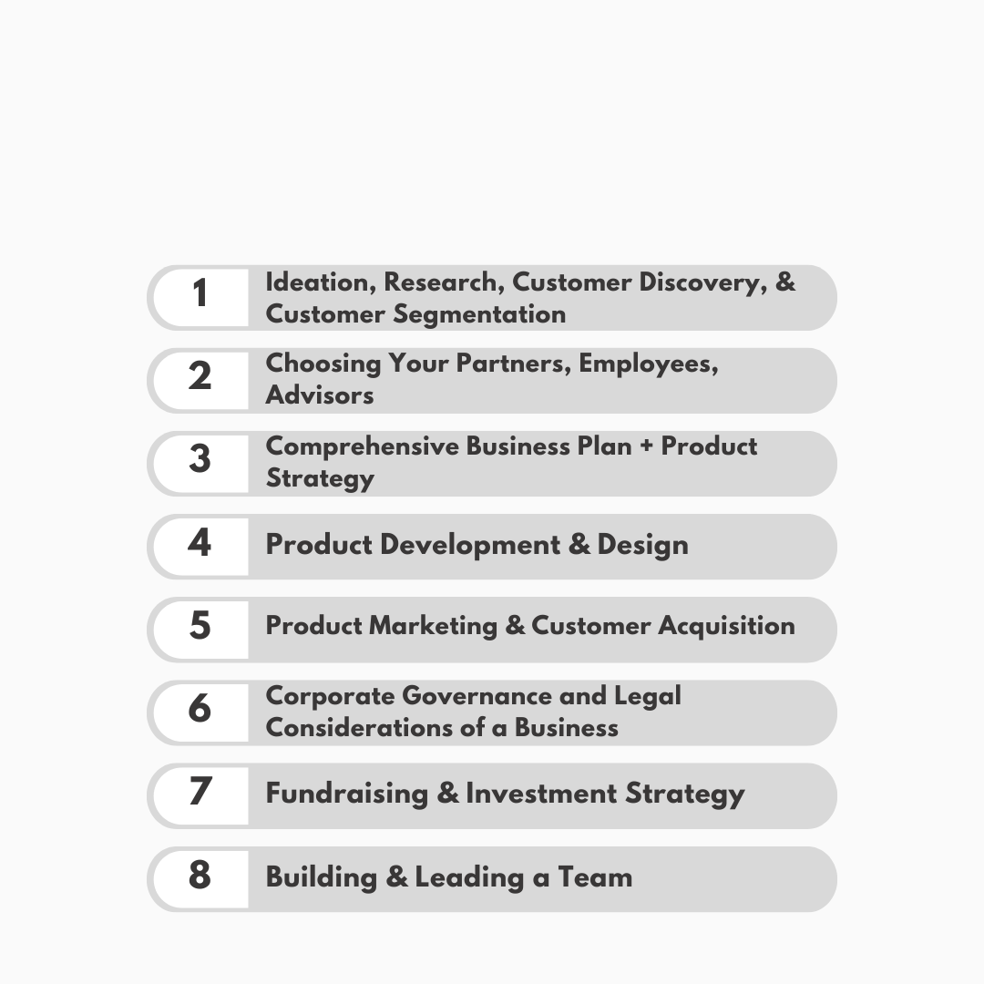
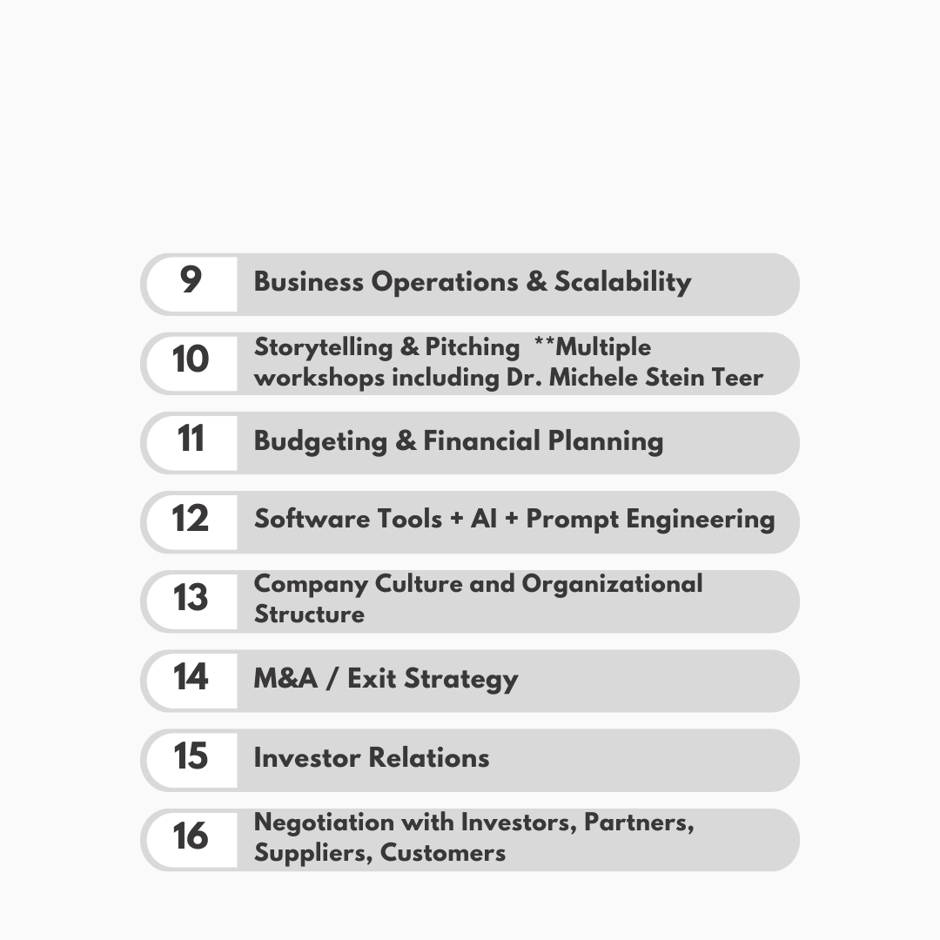
VERSION BRAVO CURRICULUM
Notes:
Combine 10-12

Slide 8
TEAM

Slide 9
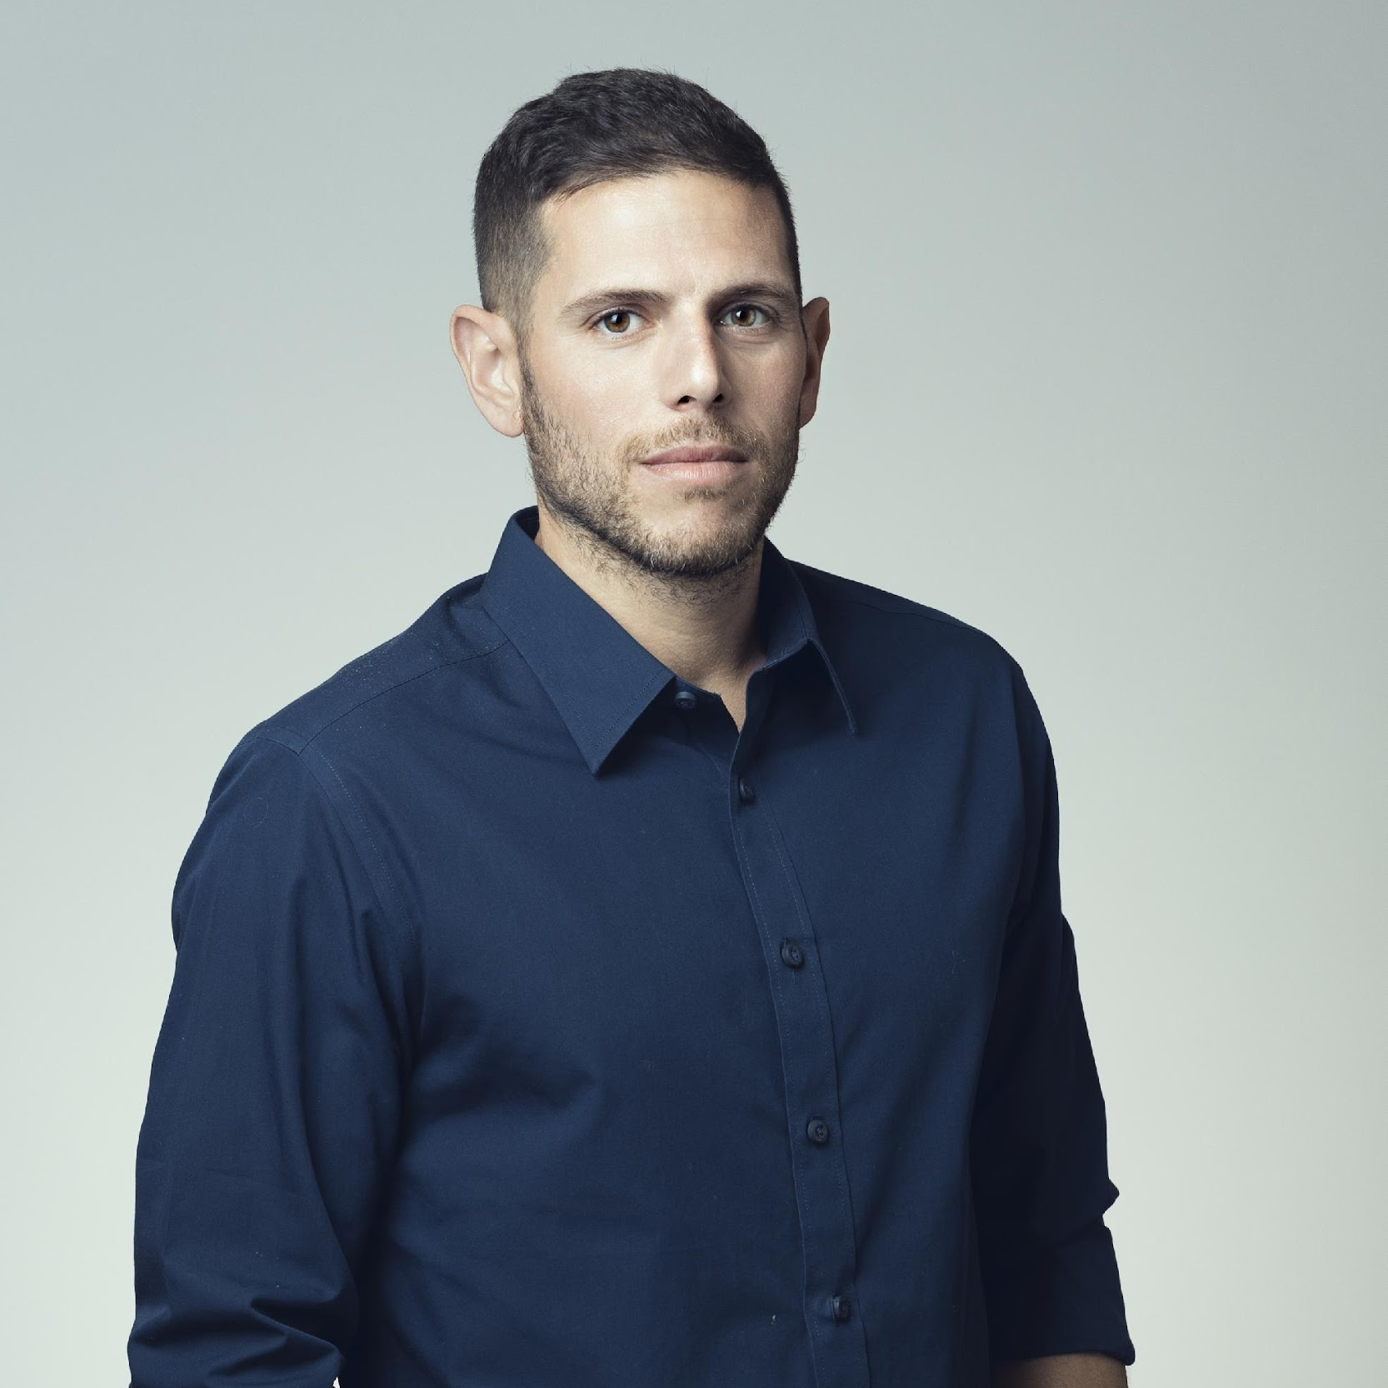
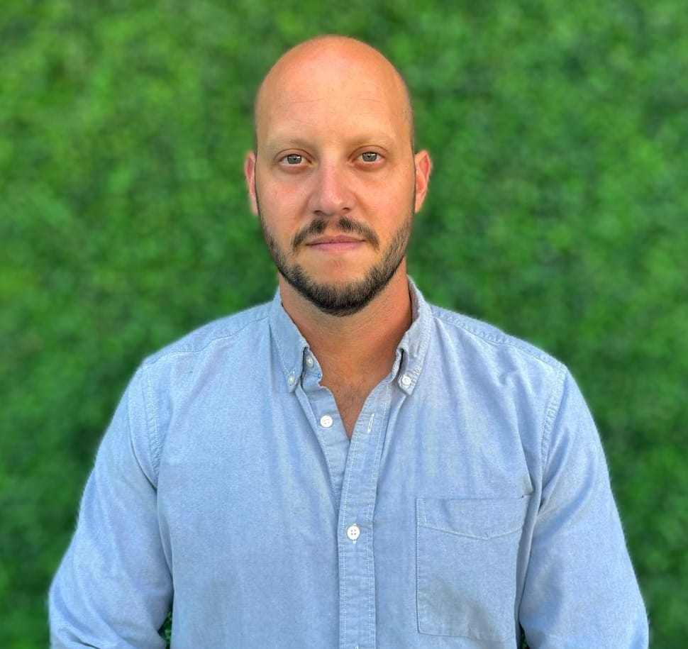








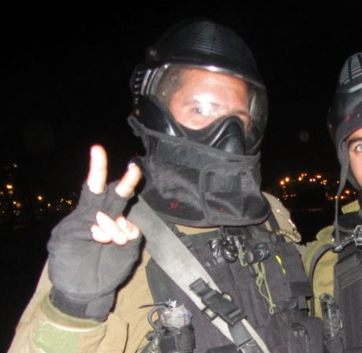
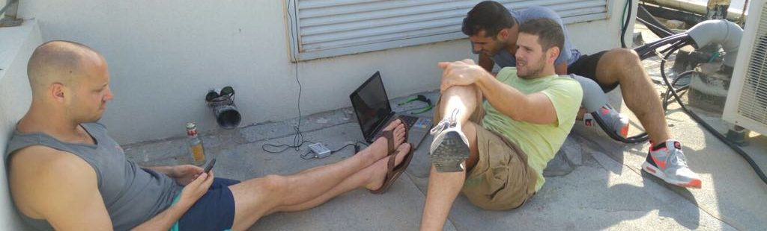
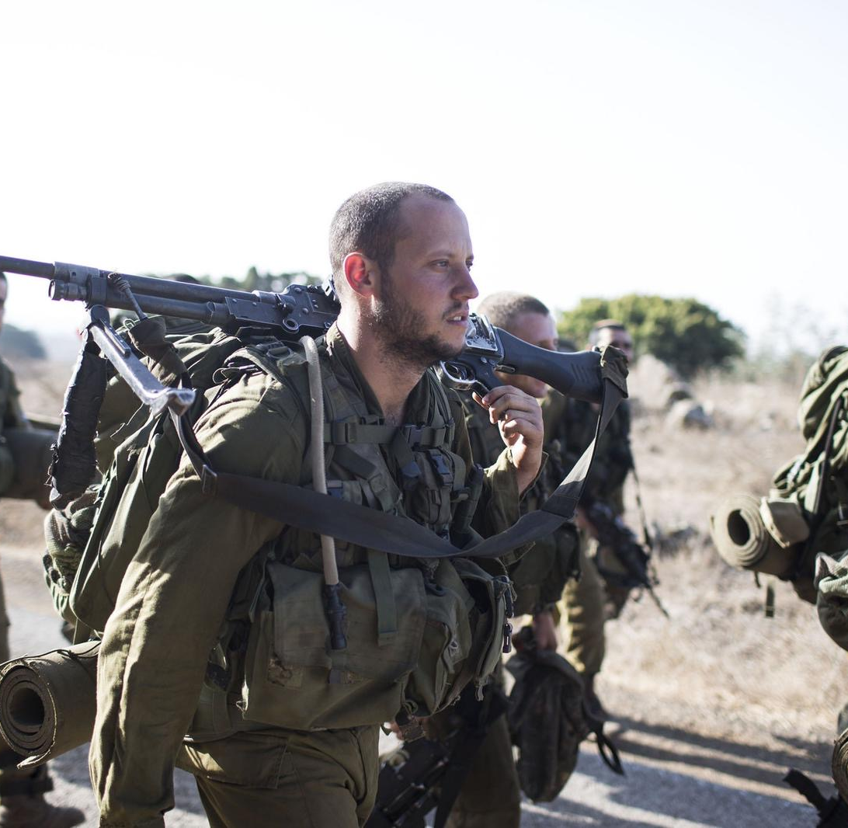
General Partners
Combat Veterans → Entrepreneurs → Investors
Lear Innovation Ventures
Nuri Golan
Adam Weiner
Managing Director, Version Bravo, Alpha-Bet (NGO)
VP Lear Innovation Ventures
Co-Founder/CEO, EXO (Acq. by Lear)
Co-Founder/CEO, Sosivio
Co-Founder/Chairman, Navmatic (Acq. by SuperPedestrian)
Captain (Res.) Shayetet-13 (IL Navy SEALs)
B.Sc. Aerospace Engineering - George Washington Univ.
MBA, Entrepreneurship and Innovation - Technion
Chief Mentor, Version Bravo, Alpha-Bet (NGO)
Co-Founder/COO, EXO (Acq. by Lear)
Co-Founder/COO, Sosivio
Co-Founder/Board Member, Navmatic (Acq. by SuperPedestrian)
Director of Innovation, Lear Innovation Ventures
IDF Paratrooper
BA, Political Science – U. Arizona
MBA, Entrepreneurship and Innovation - Technion
10+ Years
Founding
Companies
Together
Shayetet 13 -
Israeli Navy SEALs
IDF Paratroopers

Slide 10

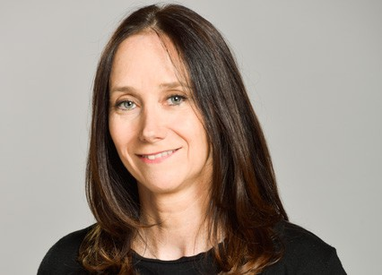







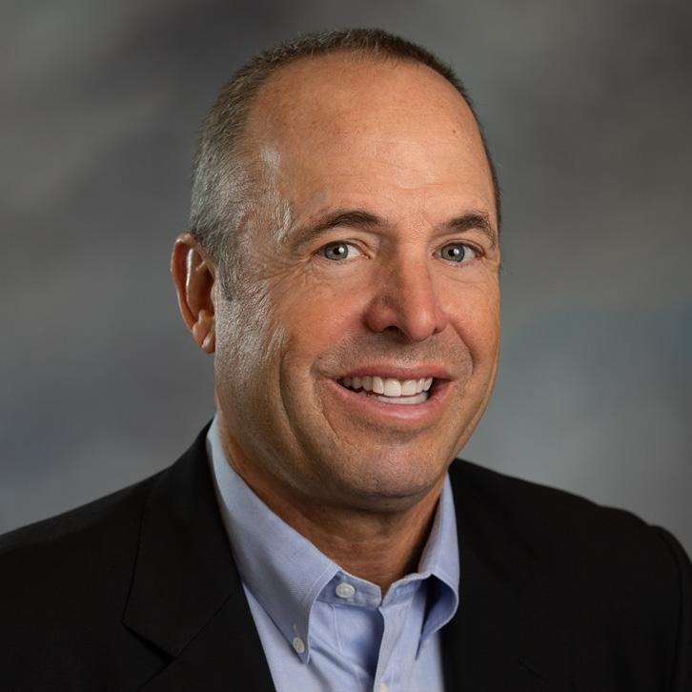






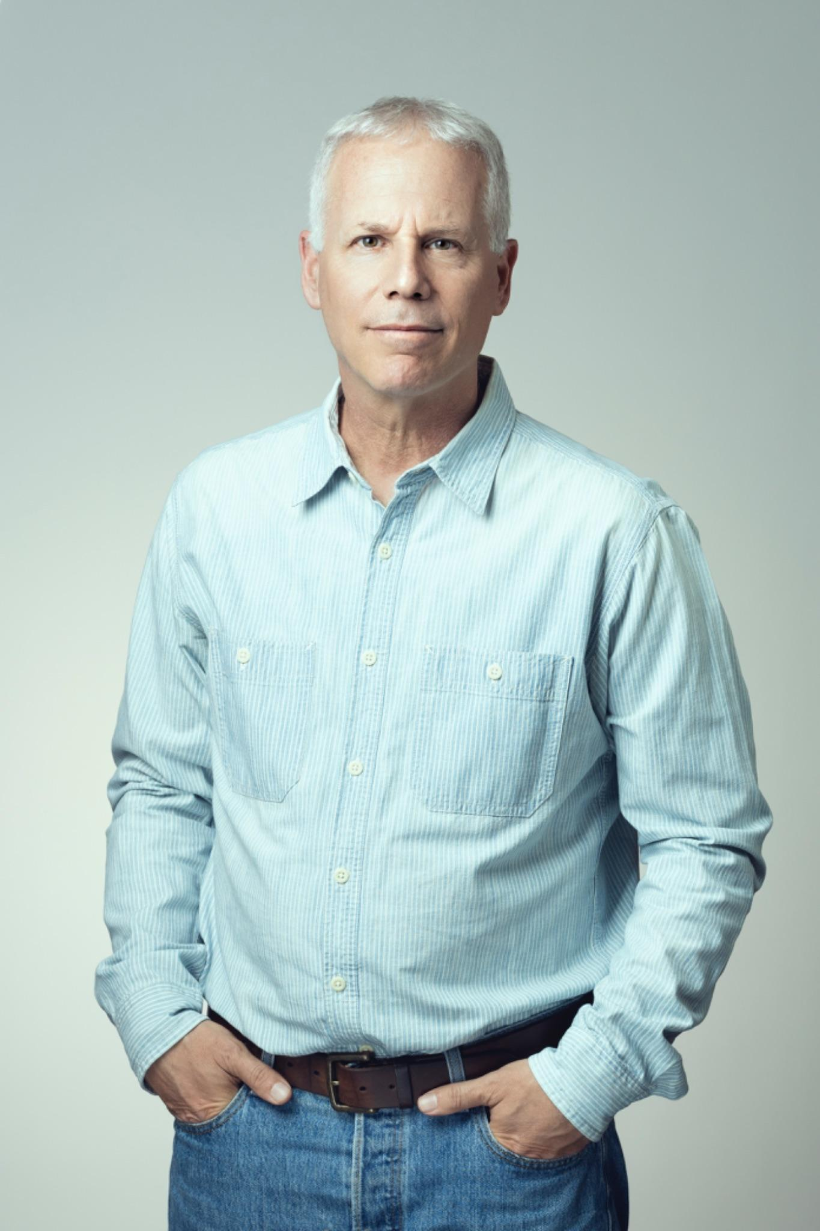




Version Bravo Staff
Dr. Gali Einav - IL Academic Lead
Head of International Undergraduate Program in Entrepreneurship and the “Upstart” program at Adelson School of Entrepreneurship, Reichman Univ.
Prof. of Digital Media, Reichman University
Prof. Digital Media/Entrepreneurship, Katz School of Marketing, Yeshiva Univ.
Led Digital Insight & Innovation Research Group, NBC Universal
Advisory Board Member, Nielsen Innovate & Yeshiva Univ. Innovation Lab
MA,. Communications and Journalism - The Hebrew Univ. of Jerusalem
PhD, Interactive Television - Columbia University
Prof. Tommy Knapp - US Academic Lead
Academic Dir., Master’s of Science in Entrepreneurship & Innovation, USC
Associate Prof. of Clinical Entrepreneurship @ Lloyd Greif Center for Entrepreneurial Studies @ Univ. of Southern California
Founder, Club Sportswear & Honolua Surf Co.
Partner, Blue Jay Bay Ventures
Board Member, Ameritas
BBA & MBA,. Communications and Journalism - Univ. of Southern California
Yotam Dagan, MA, MC-MPA - Director of Growth
Co-Founder/CEO, Dugri Inc.
Clinical Psychologist
Founder, Momentum (IDF Transition Program for released soldiers), Maoz (Network of Leaders), & Co-Impact
CDR (Res.) Shayetet-13 (Chief Instructor & Unit Psychologist)
M.A., Clinical Psychology - University of Haifa
MC MPA, Harvard University

Slide 11
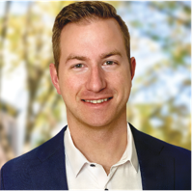




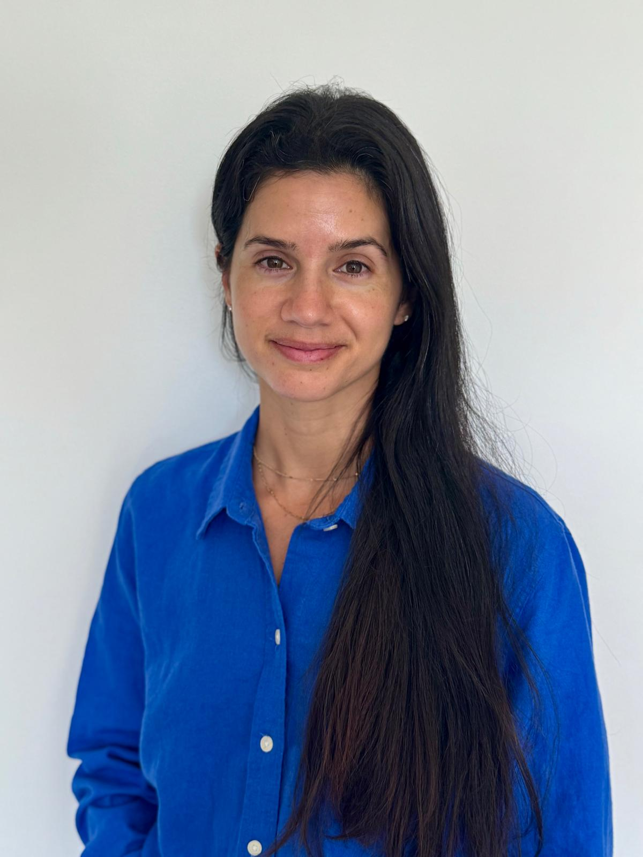





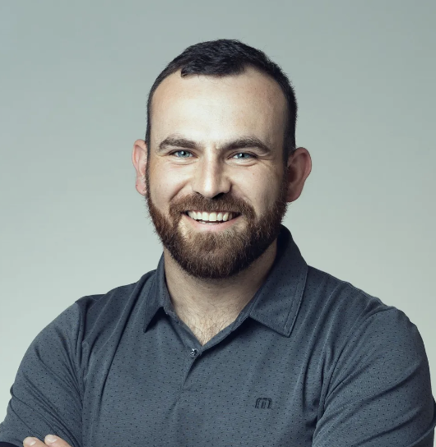




Version Bravo Staff
Jeff Ross - US Veteran Network Lead
CEO & Co-Founder Brecourt Solutions Inc.
Greater Chicago Area FOB Leader, SEAL Future Foundation
Special Operations Chief Petty Officer (Res.), US Navy SEALs
B.S. Biology/Medical Science - Western Illinois University
Eden Golan - Program Manager
Associate Producer, Vogue
Chief of Staff, CRO Office, Dick Clark Productions
Associate Producer, Manifold
Producer/Product Manager, Google
M.B.A - Tel Aviv University
Grant Goldberg - Director of Program and Operations
Associate Director, AFINS
Assistant Director, YU Innovation Lab
Special Forces, Nahal Brigade IDF
B.S. Sports Industry/Logistics
ADD TAMIR

Slide 12
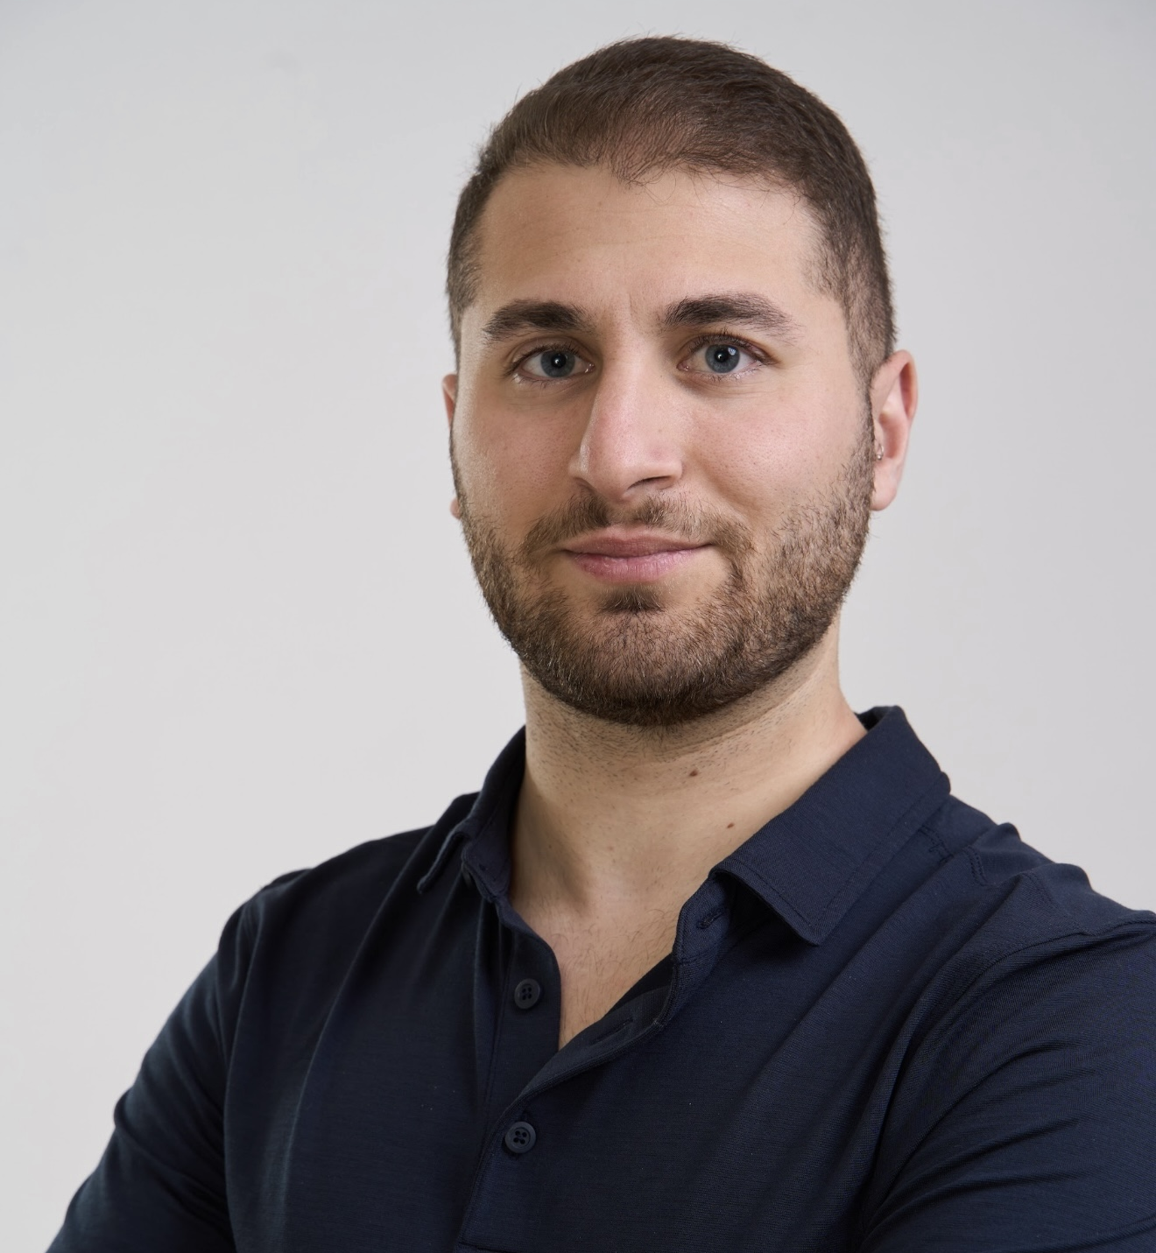
Version Bravo Staff
Tamir Sida
• Chief of Operations (Res.), 55th Brigade, IDF • Project & Product Manager leading complex technology programs in defense and innovation sectors • AI/ML-focused software and full-stack web application developer • Advisor to senior military leadership on data infrastructure and decision-support platforms • Currently completing a double major in Computer Science and Entrepreneurship at Reichman University

Slide 13
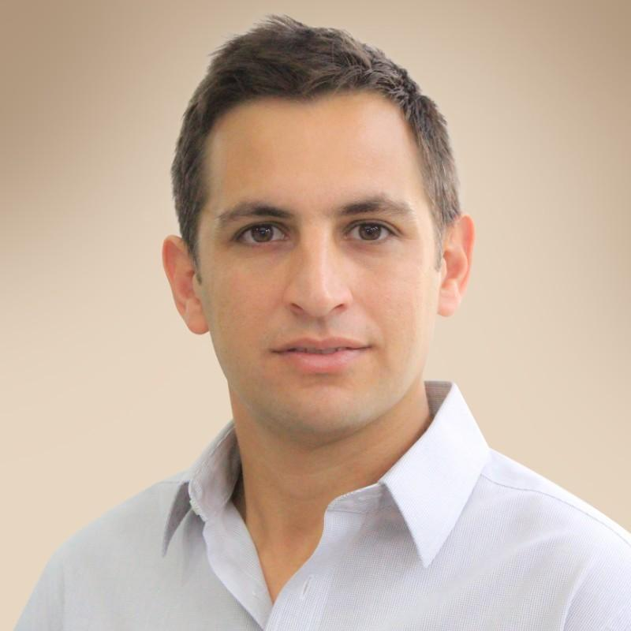
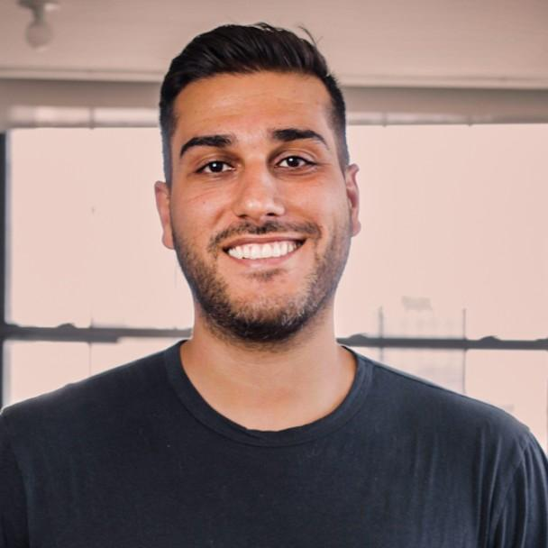
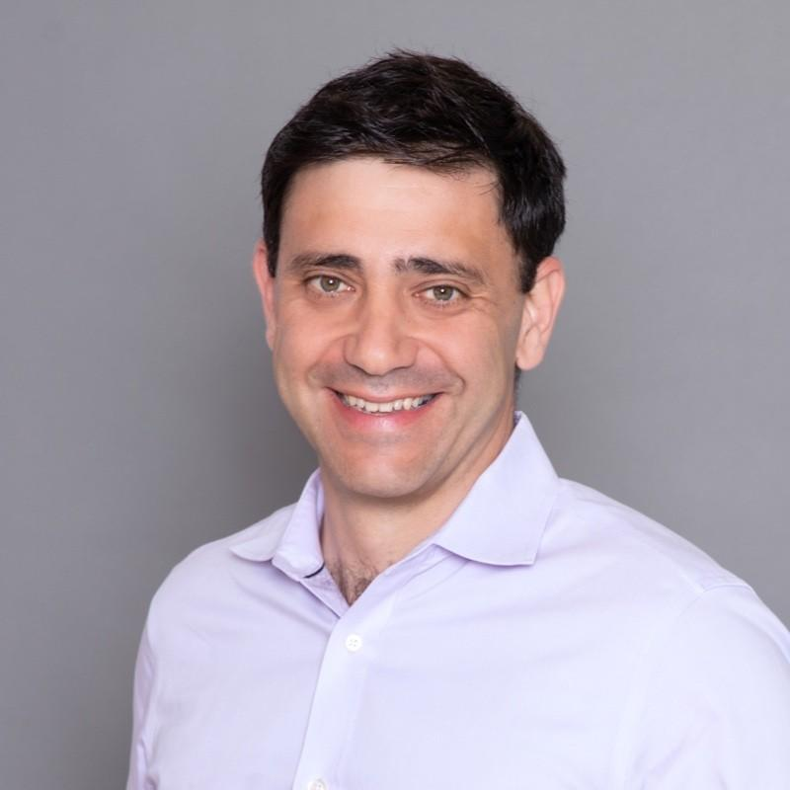
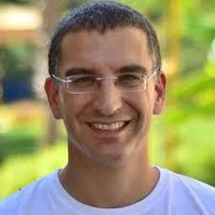



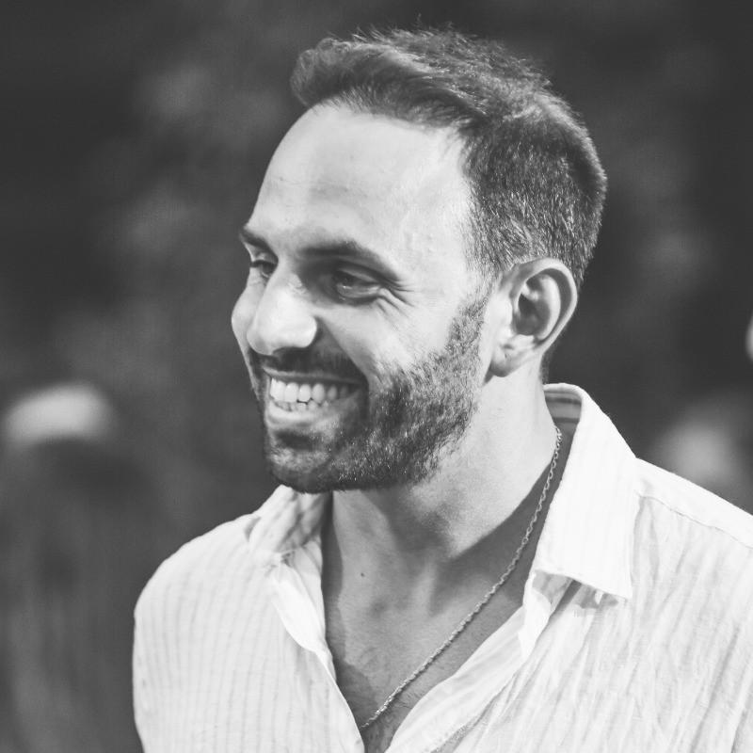
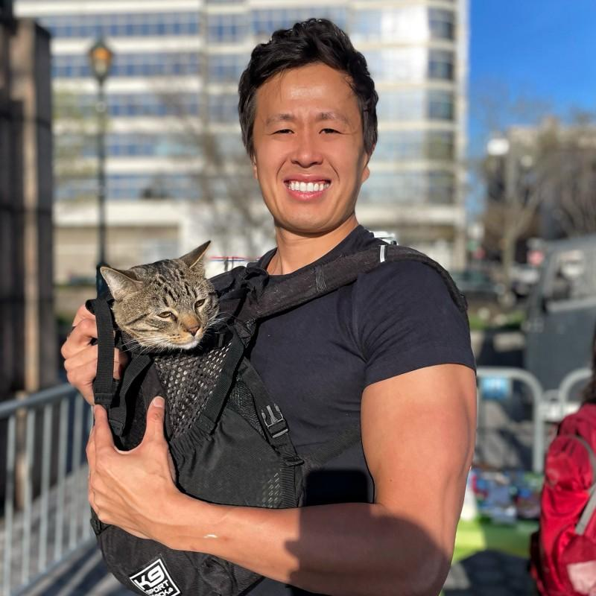
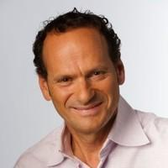
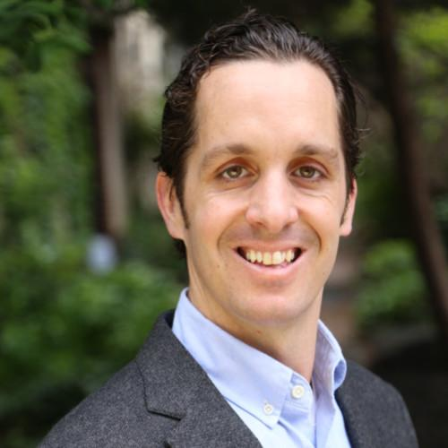
Mentors
Rami Lachter Co-Founder - Flare
Isaac Zafarani Co-Founder - Vero,
EXO (Acq.)
Tal Brown Co-Founder - Zone 7
Avner Braverman Founder - Voia
Oriel Raveh
Founder - Tipping Point
Sonny Tai
Founder - Acute
Yochai Rozenblat
Serial Entrepreneur
Rob Huberty Co-Founder - ZeroEyes

Slide 14
Fund Mechanics

Slide 15
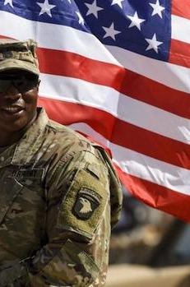
Fund Mechanics
20% Carried Interest
1.25% Management Fee (Avg.)
Up to 5% of Profit Donated to Veteran Organizations (prior to GP distribution)
Minimum Investment: $100,000 USD
GP Investment: 2% of Target
Investment Period: 2 Yrs / 2 VB Cohorts (1 Yr. Ext. Option)
Fund Life: 10 Years (2 Yr. Ext. Option)
Fund Structure: U.S. Fund
Target Fund Size: $5M

Slide 16
Application Process (Company Perspective)
Total Process: 1 Month Application and Acceptance Window
1
2
3
4
Week 1
1-3 Intro Meetings – Company receives a go/no-go for continued diligence.
Week 2
1-2 Domain expert meetings / calls - (leveraging advisory network)
Week 3
Diligence & follow on inquiries
Decision to Invest or Pass
Unanimous Decision Required from Both Partners
Our Commitment to Startups:
Transparent Process - Minimum of a weekly update to founder
Transparent Timeline - Max of 1 Month from application to investment decision
Transparent Feedback - Yes or no, we commit to provide the Deal Memo to the companies.
Support in the advisory capacity that they would like/need
Notes:
Add step 1 - application

Slide 17
Check Size: $100K
Target
Ownership:
3.33%
Founder – Market Fit
Is this Founder a fit for their target market?
Why now?
Team dynamics and makeup
Initial Investment Criteria
Unique Value Prop
What are the barriers for other entrants?
What gives this company an unfair advantage to create or win market share?
How aware are they of their competition/alternatives?
Market Opportunity / Business Viability
Is the market big enough for venture scale?
Have others tried in this space and failed? Why? What is going to be done differently?

Slide 18
Follow On Investment Criteria
A disciplined approach to executing business plans, managing resources, and adapting to market changes
Strategy over Money
Evidence of growing customer interest and adoption
Signals of Product Market Fit
Customer Demand Signals
Discipline and Focus
Founding Team Dynamics
Complementary Skills and Expertise
Shared Vision and Goals
Effective Decision Making, Communication, and Conflict Resolution
Resilience and Adaptability
Check Size:
Up to $250K
Target Ownership: 2-4%

Slide 19
Investments/Portfolio

Slide 20
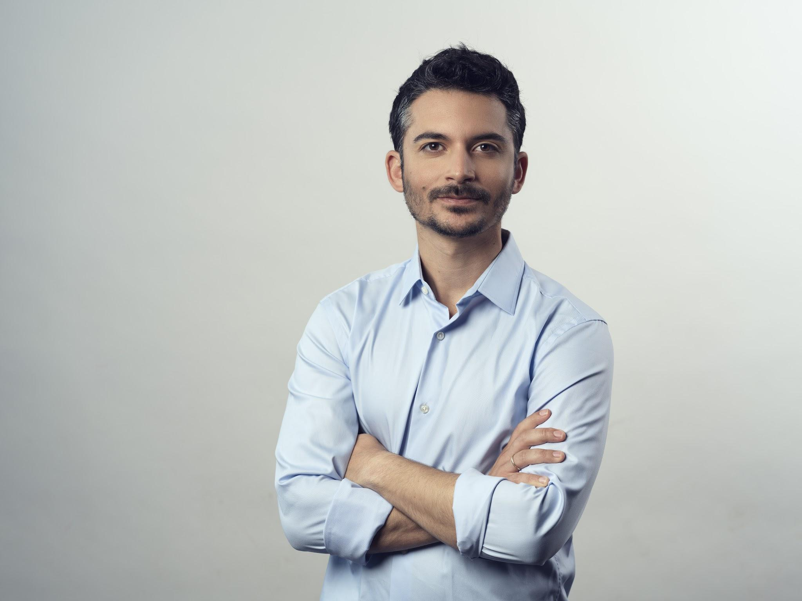
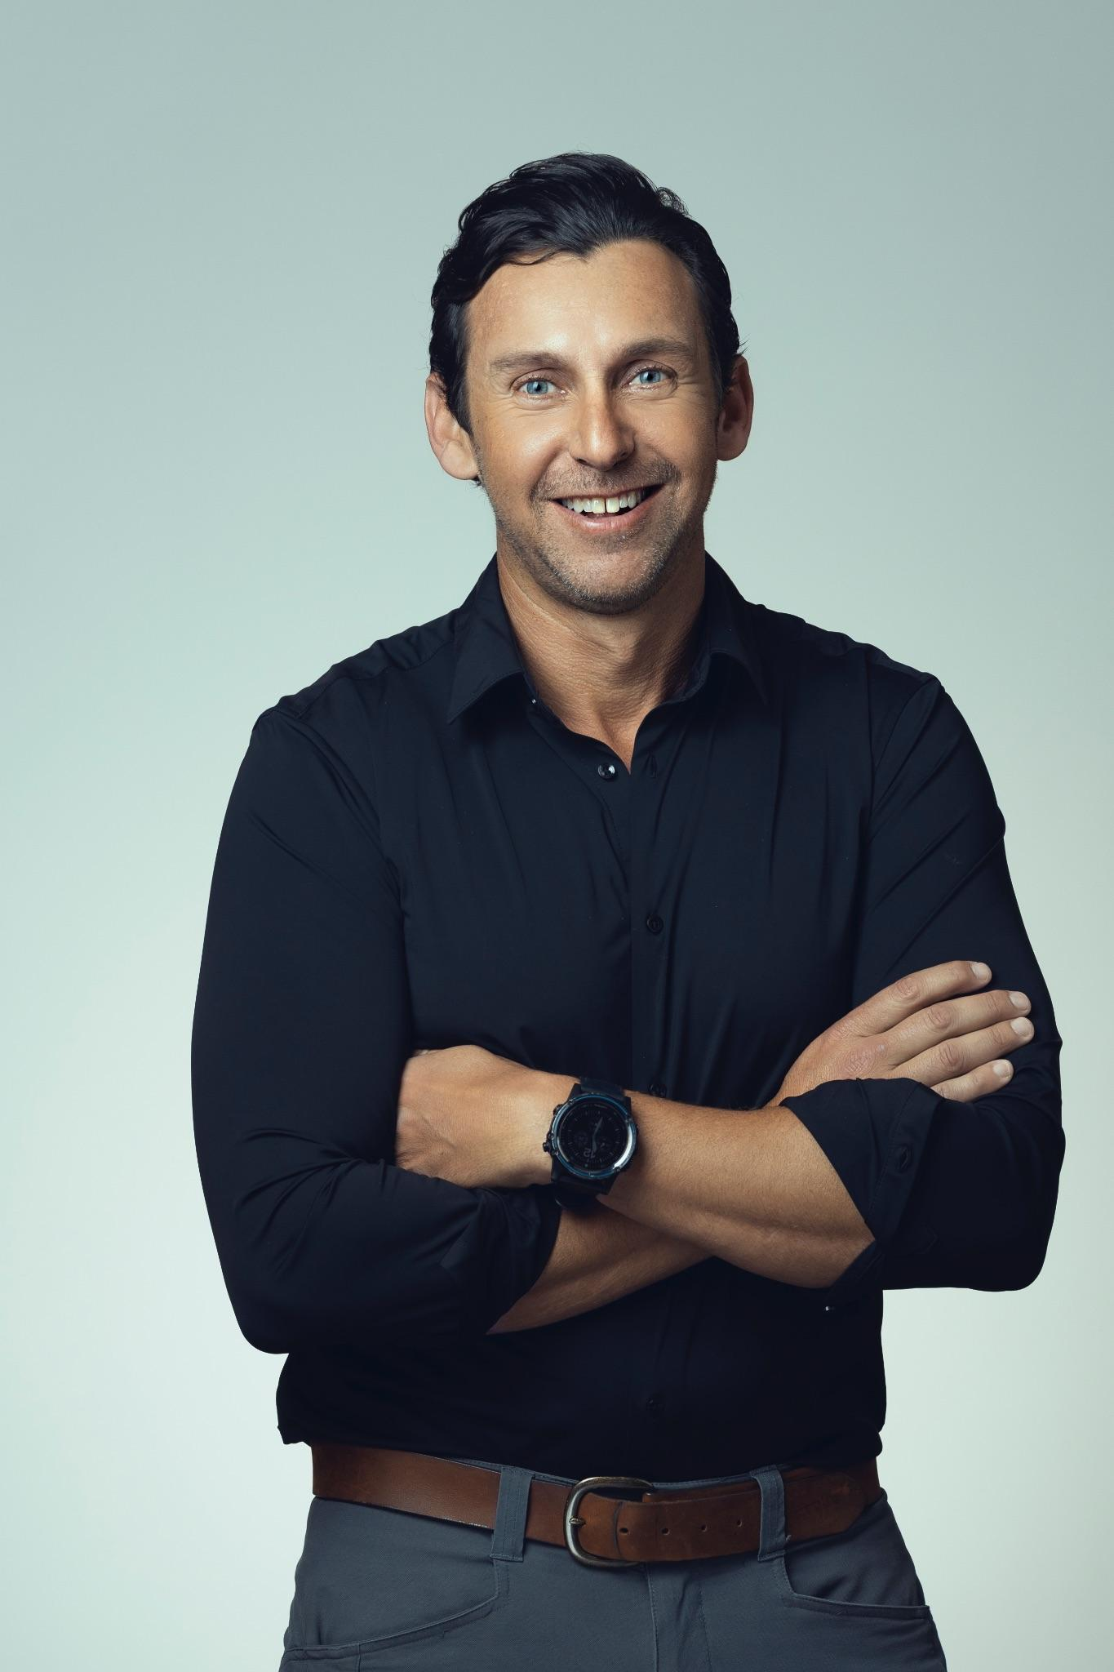

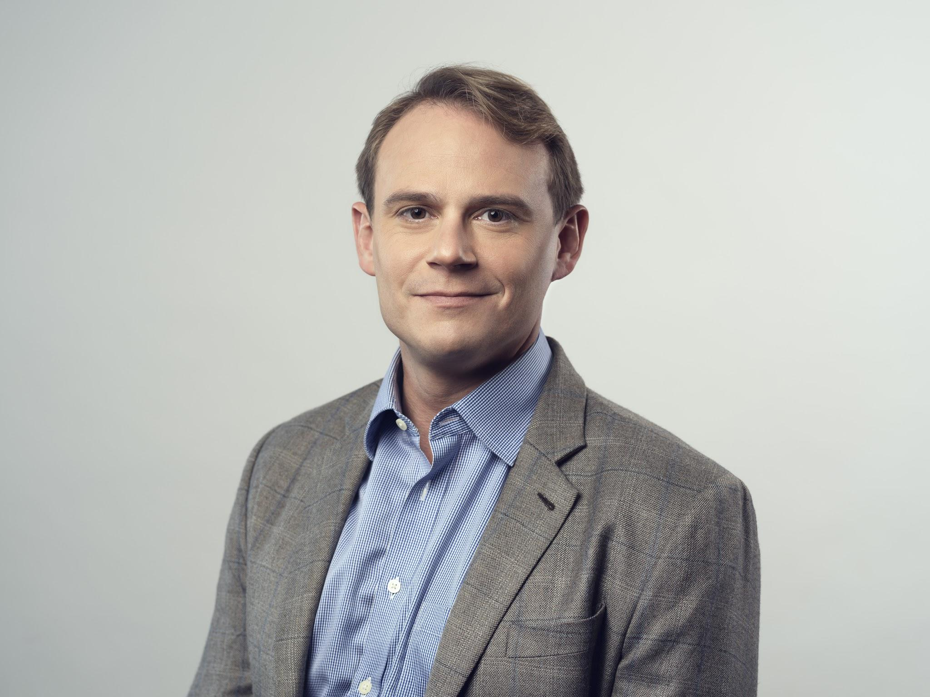

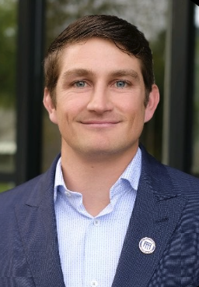


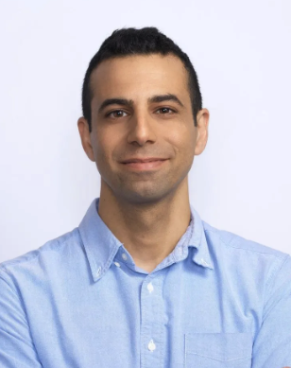
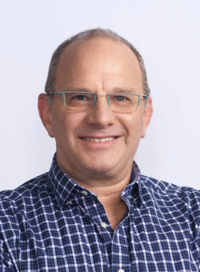
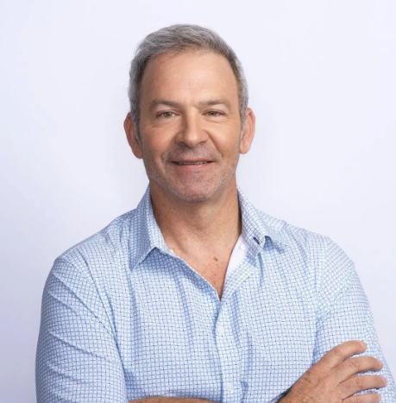
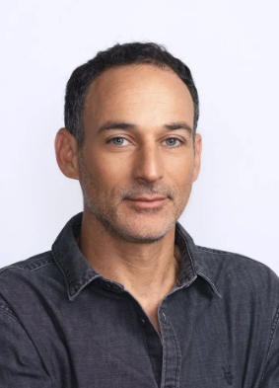




VB Rising Stars
Cohort 1 - 3
Yahav Regev
#003
Kaj Larsen
#002
Patrick Nanson
#003
Brad Denn
#001
From $0 to $10M in Sales in
<1 Year
Company was acquired by Siebert (SIEB).
Raised $1.5M Seed following VB.
Raised Series A and awarded several $M in SBIR Grants
Cohort 4
Zach Bergerson
Rafi Neuman
Spencer Calvin
Arik Pinto
Raising Seed Round. Selling to Ukrainian Soldiers on the battlefield.
Raising Seed Round. Closed $1M Contract with Israeli Health System and Pilots with US Hospitals
Raising Seed Round. Awarded several Gov contracts for sale of Rare Earth Minerals/Metals.
Raising Seed Round. Accepted to leading Aquatech accelerator.

Slide 21
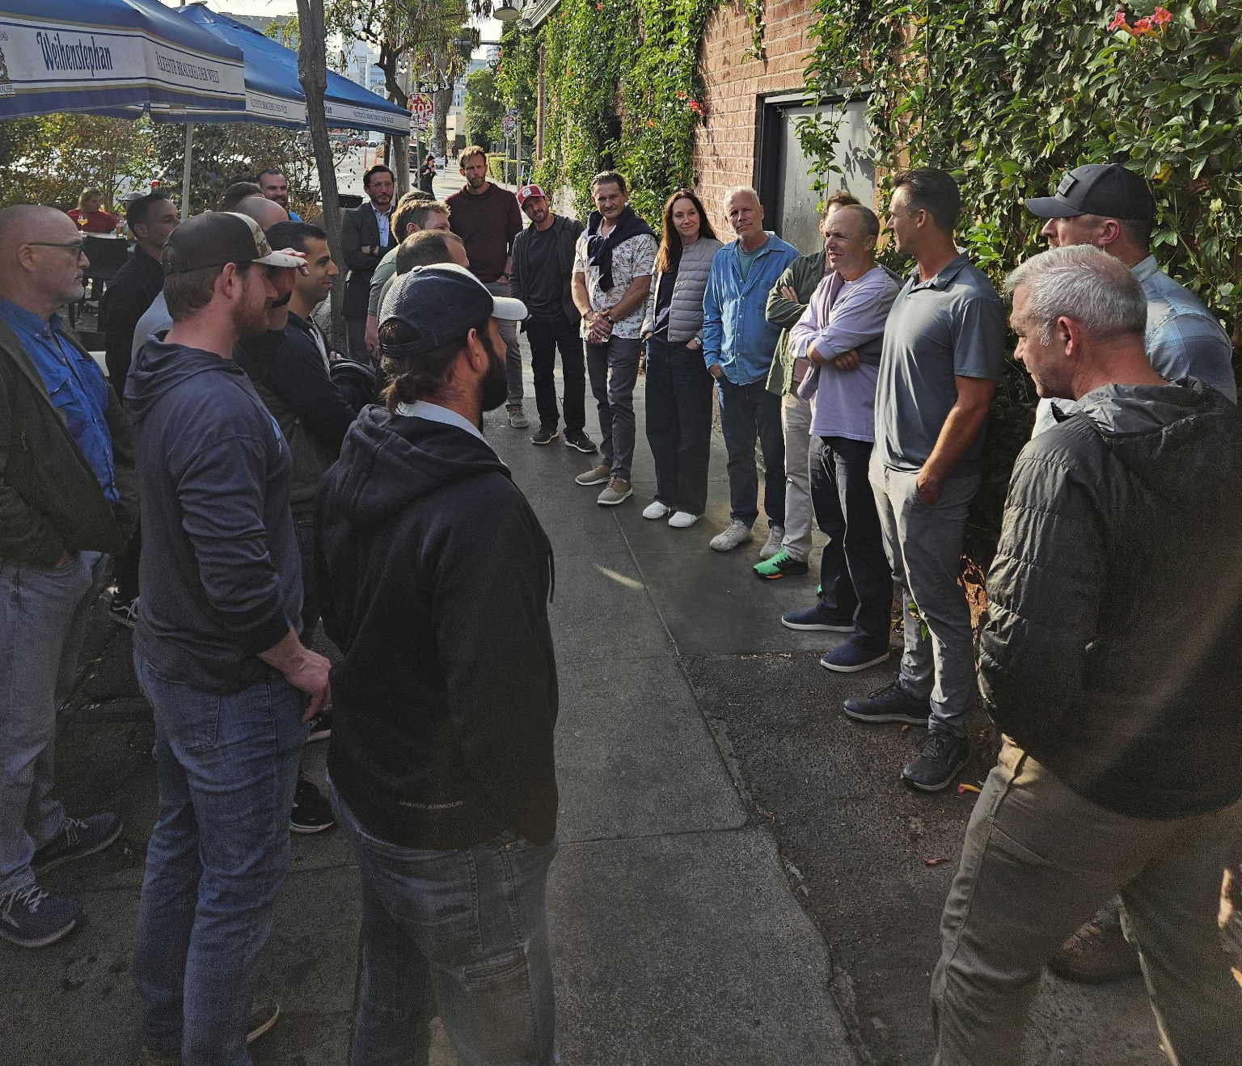
General Partner Portfolio / Track Record

Slide 22


Proven Track Record
Matt Bielski
DEFIANCE ETFs
Defiance ETFs is a leading financial firm at the forefront of ETF innovation.
Our suite of ETFs is purposefully designed to capture the potential of disruptive technologies and emerging industries, including artificial intelligence, machine learning, quantum computing, 5G, and hydrogen energy. These funds are tailored to meet the needs of the next generation of investors, offering targeted investment strategies in sectors poised for transformative growth.
Special Forces
IDF Paratroopers
Total Ownership: 1.90%
Net Investment: $260,000
Current Value: $3,800,000
TVPI: 14.61
Pre-Seed (July 2018)
Advisory Services
~$4B AUM
Invested $260K in pre-seed SAFE and Joined as Operating Advisors.
Guided early GTM and Strategy. Received 0.5% in non-dilutive exit bonus.
Industry Benchmark Market Cap = 5% of AUM Translates to $200M valuation.

Slide 23

Proven Track Record
ARIEL DESHE
TRIALKIT INC.
Leveling the playing field in the criminal justice system by providing defense attorneys with the tools they need to effectively represent clients in today’s digital world.
TrialKit provides a smart, streamlined solution for legal professionals to handle discovery data. Our platform simplifies the review and analysis process, allowing lawyers to focus on strategy and client outcomes without getting bogged down by the data deluge.
Special Forces
IDF Paratroopers
Total Ownership: 1.86%
Net Investment: $145,000
Current Value: $279,000
IRR: 1,726%
TVPI: 1.92
Pre-Seed (Feb ‘24)
Advisory Services
Seed (Aug ‘24)
Invested $25K in pre-seed SAFE and Joined as Operating Advisors
Guided company from initial POC through product launch.
Introduced TrialKit to UpWest who led a $4.25M Seed round. Invested $150K in Seed.

Slide 24



Proven Track Record
KAJ LARSEN
GUILD
Acquired by Siebert (SIEB)
Guild is a trusted investment platform inspiring the military community to secure financial freedom through training and education.
Guild serves to increase financial literacy for those who serve. Additionally, we support military causes and organizations around the world that impact the military community.
US Navy SEAL
Version Bravo
Acquisition
Investor
Participant in Cohort 2 of Version Bravo Program
Nuri worked 1-on-1 with Kaj during the negotiation for the acquisition of Guild
Kaj committed to VBV as an LP

Slide 25




Proven Track Record
Idan Levy
Idan Hassan
Skana Robotics
Skana Robotics is developing expendable autonomous maritime vehicles that give small Western Navies the tactical and strategic advantage at sea for today and tomorrow’s geopolitical challenges.
Our team are real end users who fought these battles on land, sea, and air.
IL Navy Seal
Version Bravo
Advisory
Fundraising
Referral from a Version Bravo Alumni
Received Equity as trusted Advisors.
Preparing for Seed Fundraise beginning Q2 2025

Slide 26

Proven Track Record
JEFF ROSS
BRECOURT SOLUTIONS
Brecourt Solutions’ protects bystanders and first responders, instantly deploying non-violent, proactive measures against gun violence and active shooter situations. Our technologies provide integrated systems for law enforcement, work, education, retail and travel, impacting every facet of life across every industry. Our team of experts believe in the power of technology to change the way society approaches and responds to violent crime, and we’re committed to making communities safer and freer for everyone.
US Navy SEAL
Version Bravo
Pre-Seed
Joined VB
Sourced through the Version Bravo Network
Invested $125K in SAFE in Oct. ‘24
Joined VB as US Veteran Network Lead

Slide 27


Proven Track Record
Corey Feldman
Protego Health
Covered Health is automating the most challenging and time-consuming elements of appealing denied medical claims for providers.
By streamlining access to diverse databases and inputs, Covered uses AI to helps RCM specialists and providers identify denial root causes, and generate appeals.
Combat Veteran Referral
Advisor
Fundraising
Received Equity as trusted advisors.
Preparing for Seed Fundraise beginning Q2 2025
Direct Referral from Portfolio Company (TrialKit)

Slide 28

Thank you
Nuri Golan
Adam Weiner
nuri@vbv.vc
adam@vbv.vc

